Slide 1
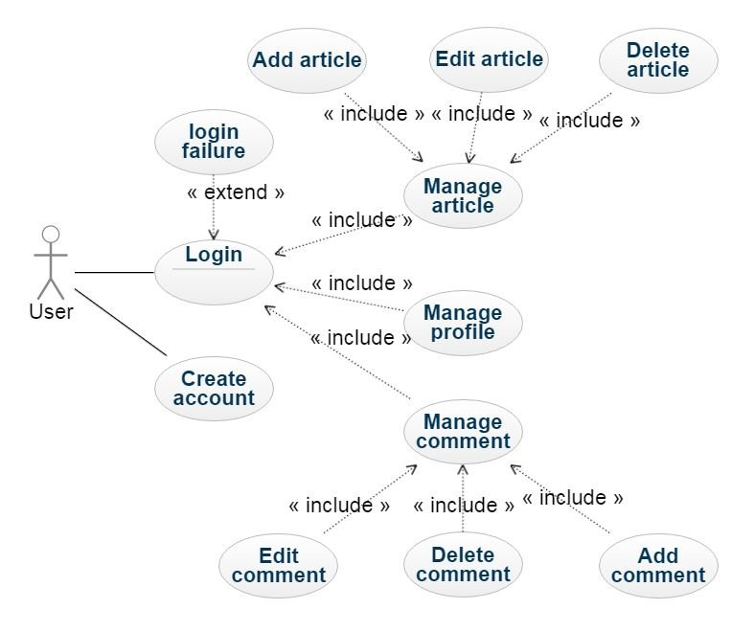
Change password
<<include>>
<<include>>
Update profile Info
<<include>>
Add category
<<include>>
Manage Category
<<include>>
Admin
Delete Category

